Slide 1
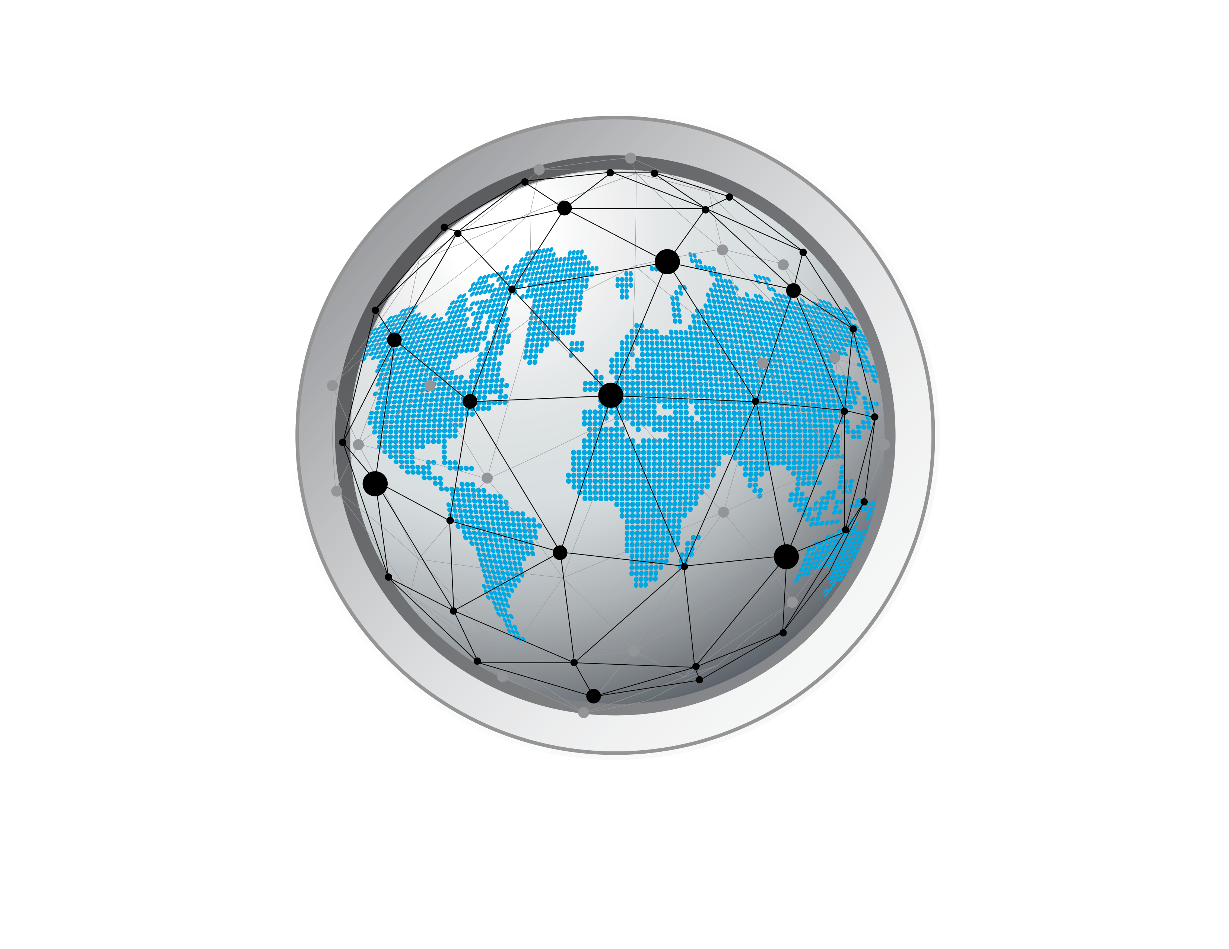
基于 NFT 的游戏赚取 NFT 资产游戏
基于 NFT 的游戏赚取 NFT 资产游戏
先锋
超级套餐
晋升
Notes:
Planet IX is created to become a revolutionary product and the real turning point for mainstream adoption of NFT based games. One of the biggest strengths of the products its the work we are doing with the the Plant a Tree organizations and some other green impact initiates that I will g through during this presentations. Planet IX is all about spreading knowledge about how humanity can fund and organize its self around making the world a better place through investing in better solutions for the planet. The organizations we met so far have a deep expertise within their own field of green impact investing and we believe our players will contribute to a lot of tangible effects due to the fact we have a lot of reach within Crowd1 network.
Planet IX is all about spreading knowledge about how humanity can fund and organize its self around making the world a better place through investing in better solutions for the planet. Some of the organizations we met so far have a deep expertise within their own field of green impact investing and we believe our players will contribute to a lot of tangible effects due to the fact we have a lot of reach within Crowd1 network.
These partnerships have made it possible for us to build something that bridges investing in real assets, such as land with forestry management, solar - and wind power parks to later on give back earnings made by these investments to the users in a monetary digital form.

Slide 2
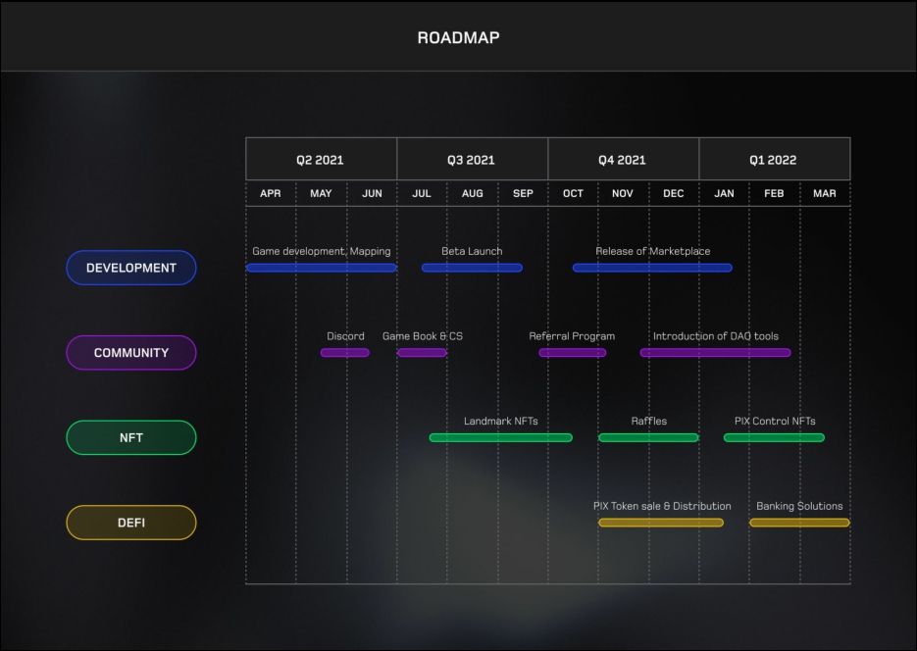
路线图
发展
游戏开发。 计算
测试版发布
市场发布
社区
不和谐
游戏本和 CS
推荐计划
DAO工具介绍
具有里程碑意义的 NFT
莱佛士
PIX 控制 NFT
PIX 代币销售和分发
银行解决方案

Slide 3
CROWD1 董事及以上的独家优惠！
先锋超级包
- 超级套餐是顶级行星 IX 套餐
- 超级礼包为您提供赢得游戏的最佳机会！
- 超级包的 PIX 是所有其他包的 10 倍！
- 更多的一切！ - 超级套装中包含更罕见、更稀有、更传奇、更强大的星球 IX PIX
- 超级包裹价值 2500 欧元
- 超级套餐将仅在 PLANET IX 市场 推出后提供给大众购买
Notes:
Planet IX is created to become a revolutionary product and the real turning point for mainstream adoption of NFT based games. One of the biggest strengths of the products its the work we are doing with the the Plant a Tree organizations and some other green impact initiates that I will g through during this presentations. Planet IX is all about spreading knowledge about how humanity can fund and organize its self around making the world a better place through investing in better solutions for the planet. The organizations we met so far have a deep expertise within their own field of green impact investing and we believe our players will contribute to a lot of tangible effects due to the fact we have a lot of reach within Crowd1 network.
Planet IX is all about spreading knowledge about how humanity can fund and organize its self around making the world a better place through investing in better solutions for the planet. Some of the organizations we met so far have a deep expertise within their own field of green impact investing and we believe our players will contribute to a lot of tangible effects due to the fact we have a lot of reach within Crowd1 network.
These partnerships have made it possible for us to build something that bridges investing in real assets, such as land with forestry management, solar - and wind power parks to later on give back earnings made by these investments to the users in a monetary digital form.

Slide 4
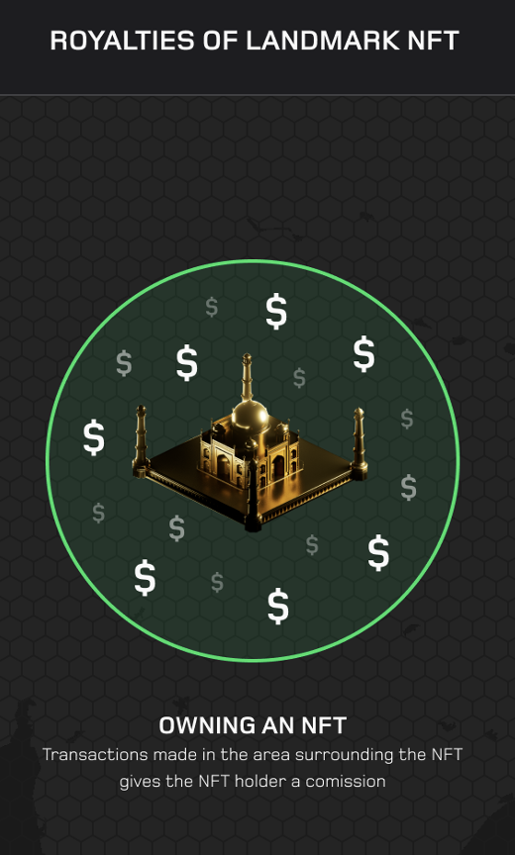
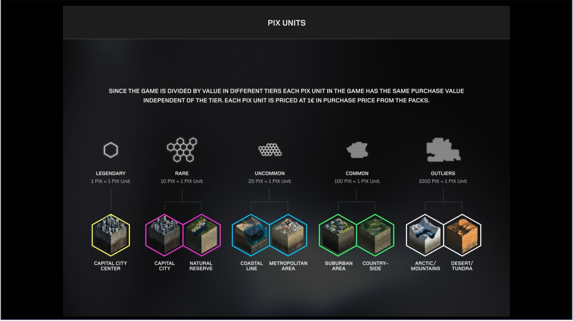
先锋超级包装
特别的 PIX 包裹掉落
具有里程碑意义的 NFT 的版税
传奇的
传奇的
稀有的
罕见
常见的
例外
拥有 NFT
在 NFT 周围区域进行的交易为
NFT 持有者提供佣金。
首都市中心
首都
自然保护区
海岸线
都市区
郊区
农村
北极和山脉
沙漠和苔原
首都市中心
Notes:
Planet IX is created to become a revolutionary product and the real turning point for mainstream adoption of NFT based games. One of the biggest strengths of the products its the work we are doing with the the Plant a Tree organizations and some other green impact initiates that I will g through during this presentations. Planet IX is all about spreading knowledge about how humanity can fund and organize its self around making the world a better place through investing in better solutions for the planet. The organizations we met so far have a deep expertise within their own field of green impact investing and we believe our players will contribute to a lot of tangible effects due to the fact we have a lot of reach within Crowd1 network.
Planet IX is all about spreading knowledge about how humanity can fund and organize its self around making the world a better place through investing in better solutions for the planet. Some of the organizations we met so far have a deep expertise within their own field of green impact investing and we believe our players will contribute to a lot of tangible effects due to the fact we have a lot of reach within Crowd1 network.
These partnerships have made it possible for us to build something that bridges investing in real assets, such as land with forestry management, solar - and wind power parks to later on give back earnings made by these investments to the users in a monetary digital form.

Slide 5
CROWD1 董事及以上的独家优惠！
先锋超级套餐
5000 欧元包括 3 个超级套餐代金券
(包裹价值 7500 欧元）
50,000 欧元包括 35 张超级包裹代金券
(包裹价值 87,500 欧元）
100,000 欧元包括 90 张超级包裹代金券
(包裹价值 225,000 欧元）
限时使用 BTC、ETH、QAICASH 或 BP 购买
Notes:
Planet IX is created to become a revolutionary product and the real turning point for mainstream adoption of NFT based games. One of the biggest strengths of the products its the work we are doing with the the Plant a Tree organizations and some other green impact initiates that I will g through during this presentations. Planet IX is all about spreading knowledge about how humanity can fund and organize its self around making the world a better place through investing in better solutions for the planet. The organizations we met so far have a deep expertise within their own field of green impact investing and we believe our players will contribute to a lot of tangible effects due to the fact we have a lot of reach within Crowd1 network.
Planet IX is all about spreading knowledge about how humanity can fund and organize its self around making the world a better place through investing in better solutions for the planet. Some of the organizations we met so far have a deep expertise within their own field of green impact investing and we believe our players will contribute to a lot of tangible effects due to the fact we have a lot of reach within Crowd1 network.
These partnerships have made it possible for us to build something that bridges investing in real assets, such as land with forestry management, solar - and wind power parks to later on give back earnings made by these investments to the users in a monetary digital form.

Slide 6
比较两种不同的游戏实用程序
游戏以随机结果开始
启用购买和收集开始
游戏更多地发展为战略决策
先发优势通常会获胜
胜利者获得有限的荣耀
投资 PIX = 幸运抽奖
单一和点差 PIX = 低价值资产
NFT 可以是个人拥有或共同拥有
资产组能够在市场上创造指数级价值
现实世界的收益率资产向 NFT 所有者产生支出
Notes:
The game starts with random luck to start building a foundation of what strategy to start developing.
While you gathered your initial collection of PIXes, you then narrow down your way forward, Maybe not buying all the streets, but waiting for a more centralized property block.
Halfway through the game of Planet IX, we will see a bundle of pix parcels getting sold for several 100-thousands of dollars.
The end goal of the game is to acquire and NFT, either alone or through a co-ownership structure called a DAO ( smart contracts agreement)

Slide 7
PIX 单元
由于游戏在不同层级按价值划分，因此游戏中的每个 PIX 单元具有相同的购买价值，与层级无关。
每个 PIX 单元的价格为 1 欧元，按套餐购买价格计算。
传奇的
稀有的
罕见
常见的
例外
首都市中心
首都
自然保护区
海岸线
都市区
郊区
农村
北极和山脉
沙漠和苔原

Slide 8
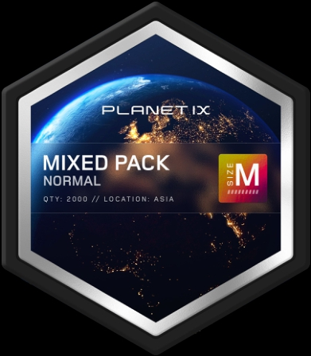
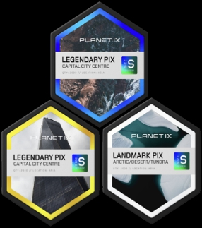
PIX PACK DROPS 如何运作？

Slide 9
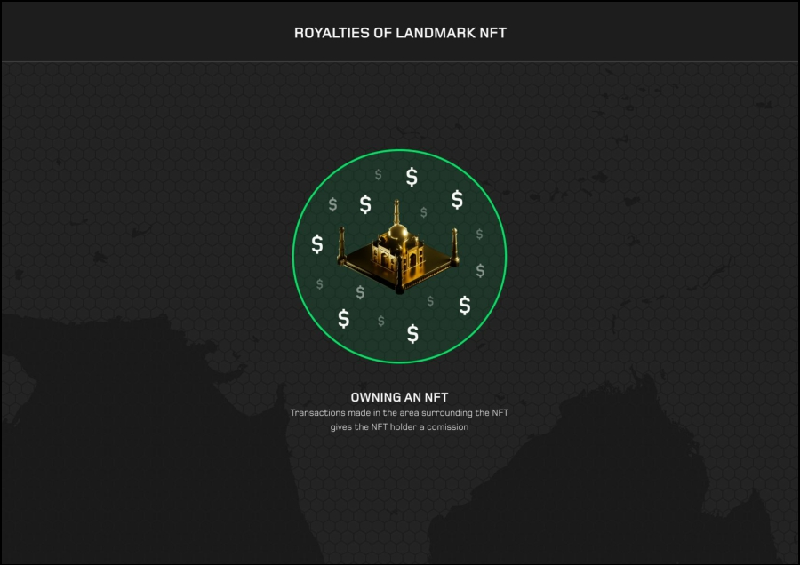
具有里程碑意义的 NFT 的版税
拥有 NFT
在 NFT 周围区域进行的交易为 NFT 持有者提供佣金。

Slide 10
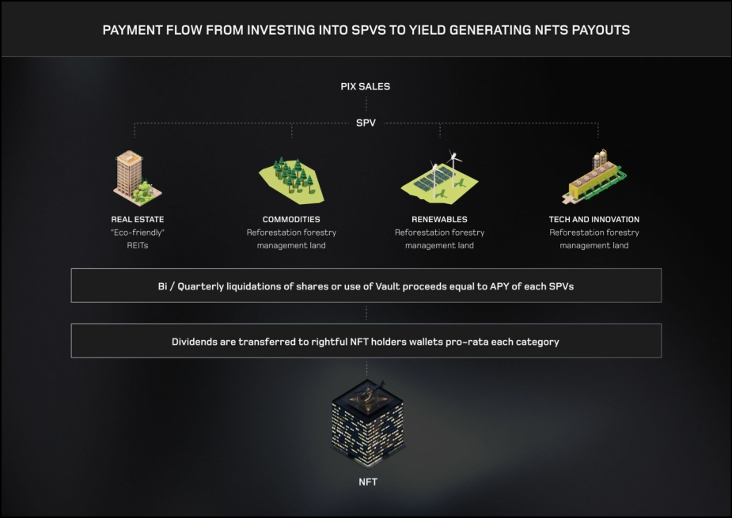
从投资到 SPV 到产生 NFT 支出的支付流程
PIX 销售
房地产
环保 R E I T
商品
造林林业管理
可再生能源
造林林业管理
科技与创新
造林林业管理
使用 Vault 的股份的 Bi/Quarterly 清算收益等于每个 SPV 的 APY。
股息按每个类别的比例转移到合法的 NFT 持有者钱包
Notes:
”20 % of all pix sales are allocated to sustainable invests, which returns are liquidated on a quarterly basis, then converted to the PIX token in a market buy operation. PIX tokens later get paid out to rightful NFT holders in the game”

Slide 11
谢谢你。

